Slide 1

Your success is our success
Maven Introduction
https://www.baeldung.com/maven
Funny Gorilla诙猩猩-IT培训

Slide 2
Learning Objectives
Maven introduction
What maven can do?
Execution process

Slide 3
What maven can do?
Manage dependencies
Define development lifecycle
Define standard folder structure

Slide 4
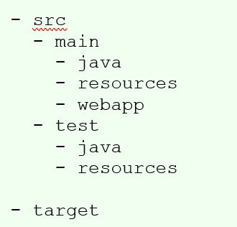
Standard directory

Slide 5
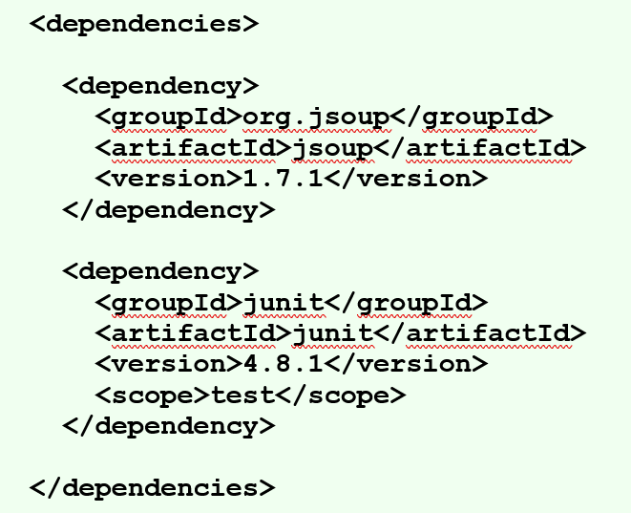
Manage dependencies

Slide 6
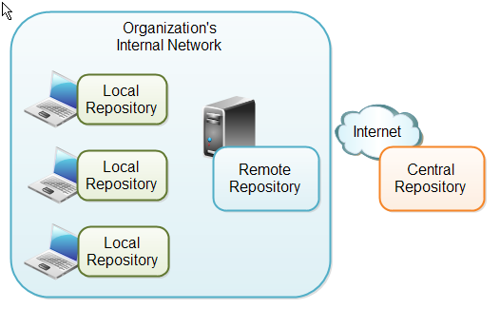
Repositories
https://repo1.maven.org/maven2/

Slide 7
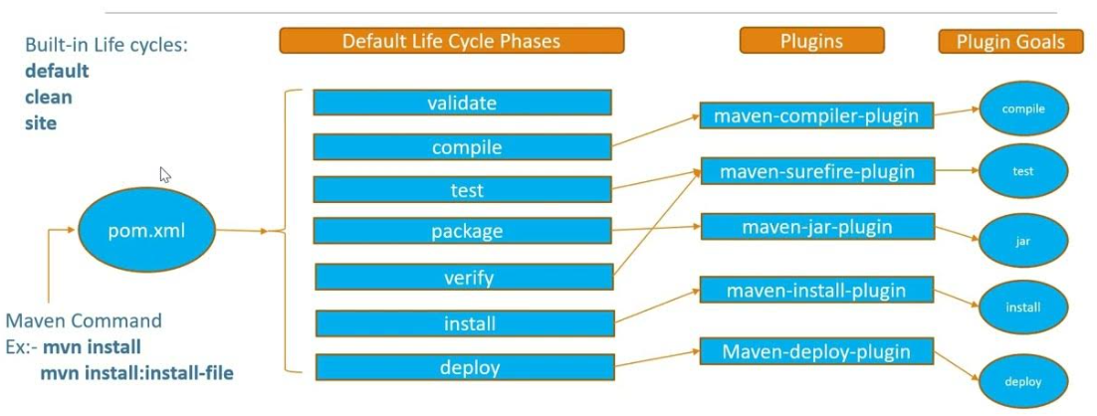
Build Lifecycle
https://www.youtube.com/watch?v=Yw5KnoH0MSo

Slide 8
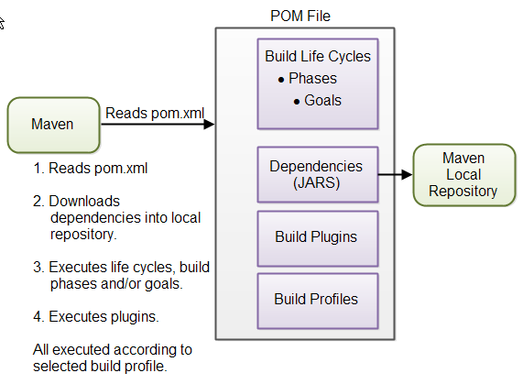

Slide 9
Plugin

Slide 10
Test related plugins:

Slide 11
References
https://learning.postman.com/docs/introduction/overview/
https://learning.postman.com/docs/writing-scripts/script-references/test-examples/

Slide 12

Your success is our success
Contact
Mail: info@funnygorilla.com.au
Linkedin: https://mt.linkedin.com/in/songqing-gu-2ba9034b/de
Web Chat: FunnyGorilla
Phone: 0420891343

